Slide 1



FAKE NEWS DETECTION PLATFORM
Addressing Misinformation with Technology
Author: Orian Teodor Octavian

Slide 2


INTRODUCTION
The Fake News Detection Platform tackles the pressing issue of misinformation by providing a mechanism for users to verify the authenticity of news content through APIs, participate in forum discussions, and request role-specific privileges such as academic or journalist roles.
Main Objectives:
Empower users to evaluate news credibility.
Provide researchers tools for media credibility analysis.
Promote media literacy in educational contexts.

Slide 3



WHY IS IT USEFUL?
Significance of Misinformation:
Impacts public opinion and decision-making.
Drives polarization and confusion.
Platform Benefits:
Enables informed decision-making.
Facilitates academic and journalistic research.
Promotes collaborative efforts to counter fake news.

Slide 4




FUNCTIONALITIES
NEWS VERIFICATION
Users can submit news claims for verification.
The system utilizes Google Fact Check API to provide credibility scores.
FORUM DISCUSSIONS
ROLE REQUESTS
Users can create threads, comment on posts, and discuss news authenticity.
Posts and comments can be moderated by admins.
Users can request a role upgrade to Academic or Journalist with justification and admin approval.

Slide 5


ACTORS AND ACCESS RIGHTS
Administrator: Manages users, role requests, and oversees moderation.
General Users: Can submit news claims, participate in forums, and request role upgrades.
Journalists:Access verification tools and contribute professionally to forums..
Academics: Participate in discussions on misinformation and utilize advanced platform features for research purposes.

Slide 6


Microservices Architecture
User Management Service:
Handles user authentication and authorization.
Manages user roles (Admin, Journalist, Moderator, etc.).
News Verification Service:
Processes user-submitted news claims.
Interacts with external APIs (e.g., Google Fact Check, Azure Text Analytics) to verify news credibility.
Stores verification results and updates claim statuses.
Forum and Community Service:
Enables discussion threads and comments.
Includes moderation tools and handles flagged content.
Benefits:
Scalability: Independent scaling of services.
Modularity: Easier updates and debugging.
Flexibility: Each service can evolve independently.

Slide 7
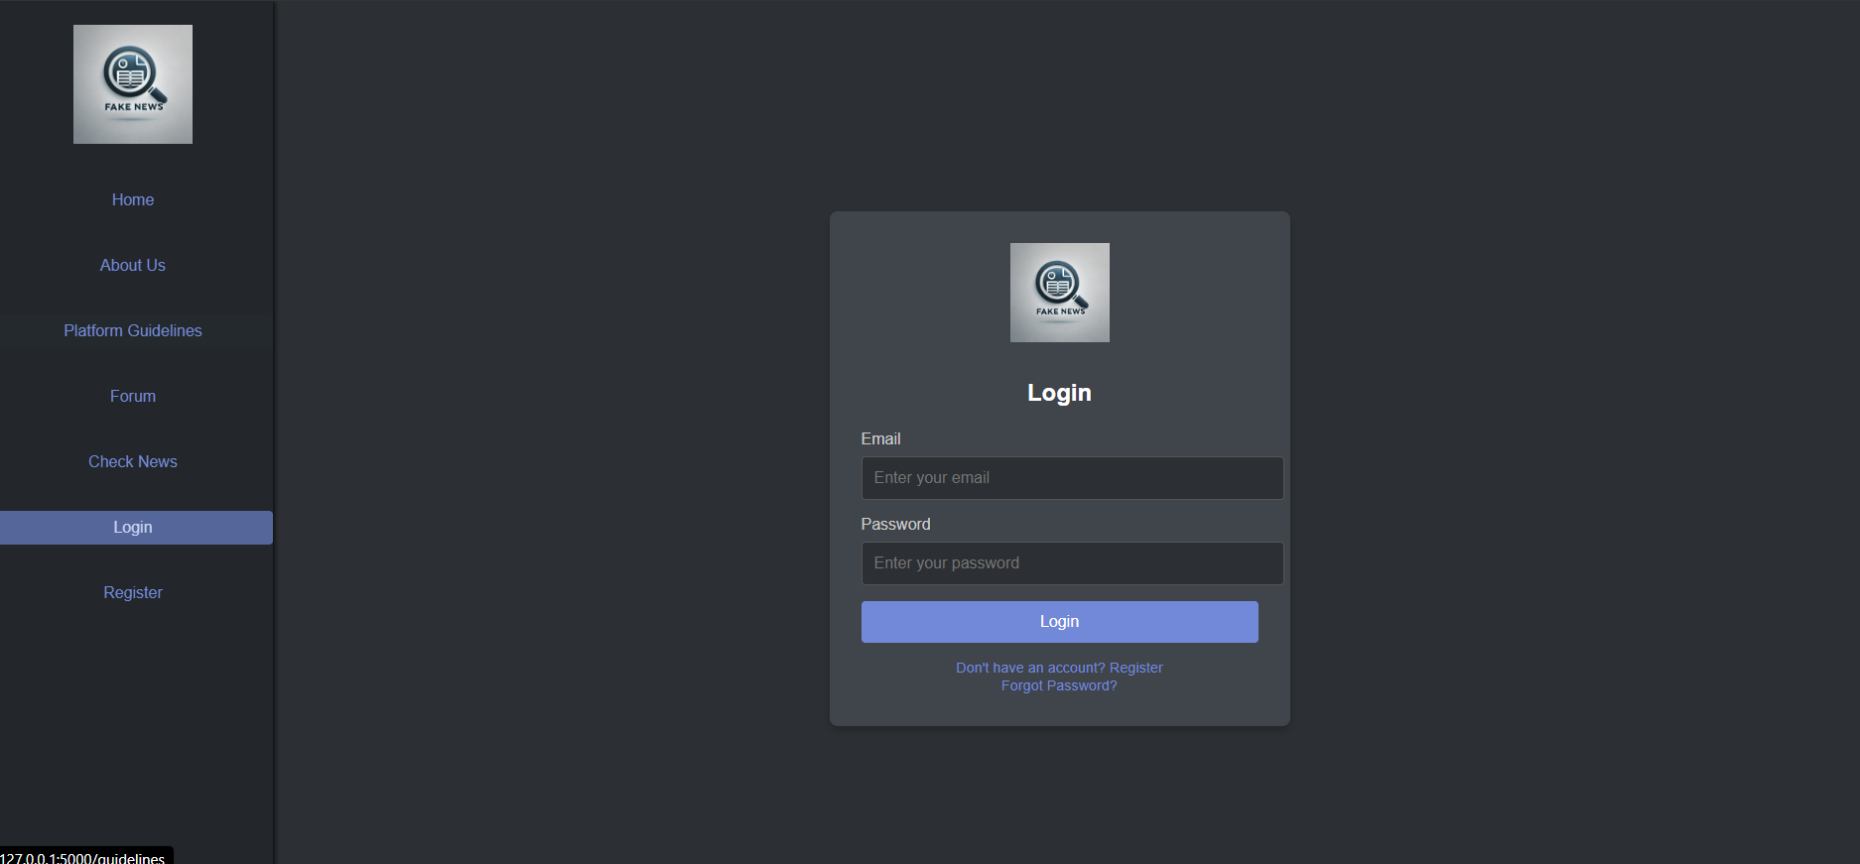
LOGIN PAGE - UI DESIGN
The login page provides secure access for all user roles (Admins, Moderators, Journalists, Academics, and General Users).

Slide 8
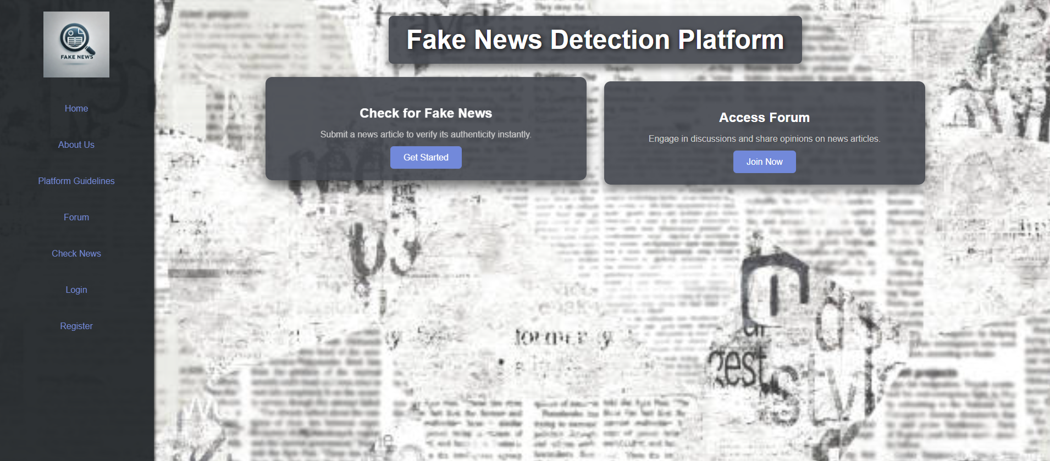
MAIN PAGE - UI DESIGN
The main page serves as the entry point for all users, offering access to platform features like news verification, forums, and login options.

Slide 9
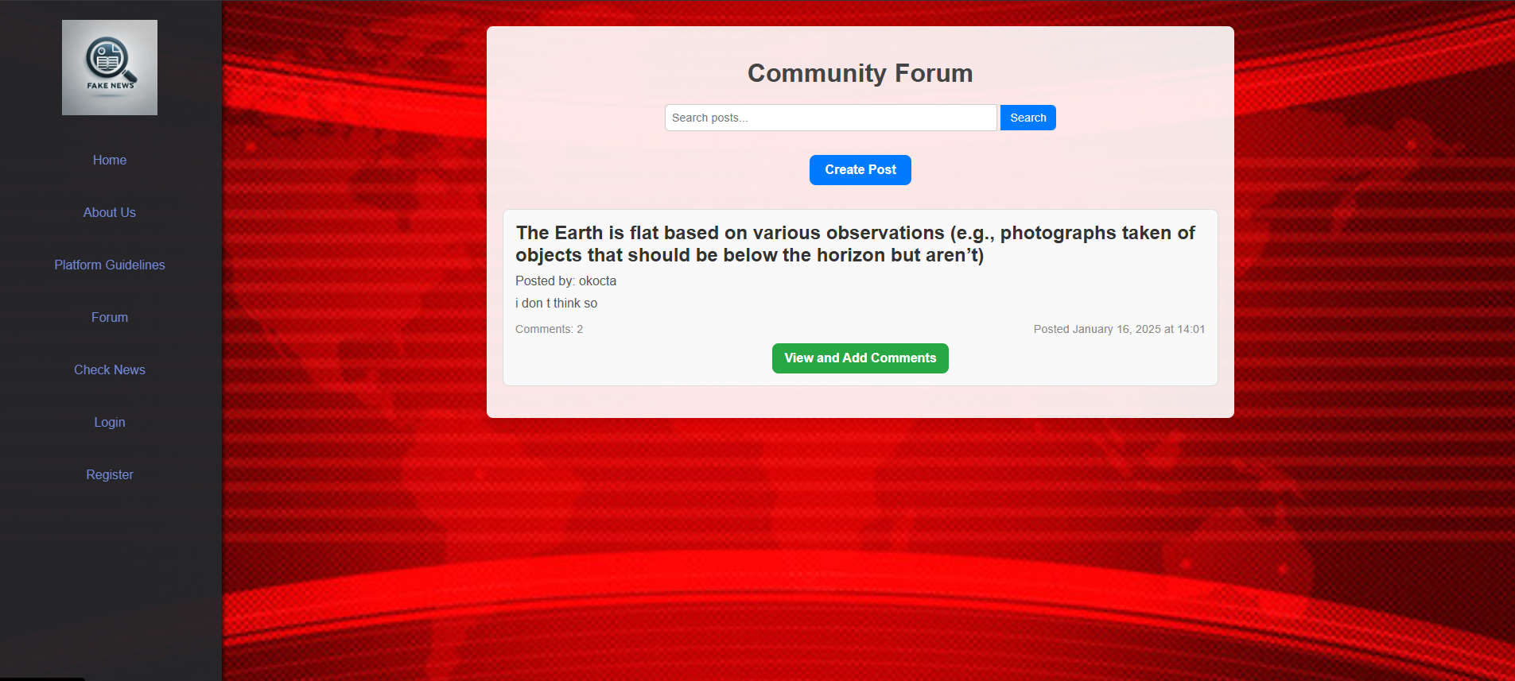
FORUM PAGE - UI DESIGN
The Forum Page serves as a community hub for discussions about news authenticity.
Sidebar Navigation: Provides easy access to essential features like "Home," "Check News," and "Register."
Post Listings: Displays posts with titles, descriptions, and timestamps, enabling users to engage with relevant topics.
Interaction Features: Includes options to create posts, view discussions, and add comments, fostering collaboration.

Slide 10
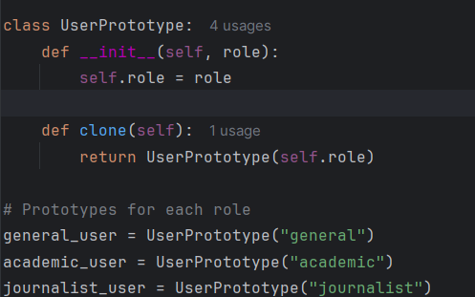
PROTOTYPE DESIGN PATTERN
Definition and Purpose:
The Prototype Design Pattern is a creational design pattern that allows objects to be cloned, creating a duplicate object while preserving its structure and initial state.
In the Fake News Detection Platform, this pattern is utilized to handle the creation of users with predefined roles efficiently.
Why Use This Pattern for User Roles?
Users belong to specific roles such as General, Journalist, and Academic. These roles have predefined properties (e.g., permissions and privileges).
Instead of creating each user role from scratch, the platform uses a prototype for each role, which can be cloned and customized as needed.
Implementation in the Platform:
Prototypes Defined:
General User: Default role with basic access.
Journalist: Role for professionals needing advanced news verification tools.
Academic: Role for educators and researchers with extended discussion privileges.
Cloning Process:
Each prototype (e.g., journalist_user) is cloned when a new user is registered or their role is updated.
Advantages:
Reduces redundant code by reusing prototypes.
Ensures consistency across role definitions.
Simplifies maintenance and scalability of user role management.

Slide 11
Testing and Validation
Crt No | Description of the bug | The date when the bug was found | Status
1 | Password Reset Functionality Missing | 15.01.2025 | Not Solved
2 | Some sidebar links lead to incorrect or non-existent pages | 13.01.2025 | Solved
3 | Forum Post Role Highlighting | 16.01.2025 | Solved
4 | Role Request Approval | 15.01.2025 | Solved
5 | Role Request Notification | 15.01.2025 | Not Solved

Slide 12

Google Fact Check API: How It Works
Query: The claim is sent to the API.
Database Search: The API looks for fact-checked claims similar to the query in its database.
Possible Outcomes:
Match Found: Returns details like the reviewed claim, verdict (e.g., False, Speculative), publisher, and fact-check link.
No Match: Indicates no fact-check exists for the query.
Limitations:
Cannot predict future events or verify speculative claims.
Only works with existing fact-checks in the database.
Result: If no match is found, the platform informs the user: "No fact-check available."

Slide 13
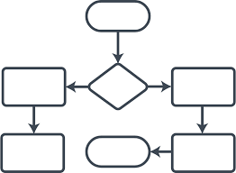
DIAGRAMS OVERVIEW
In the following slides, we will present and explain the key diagrams that outline the system's design and functionality.

Slide 14
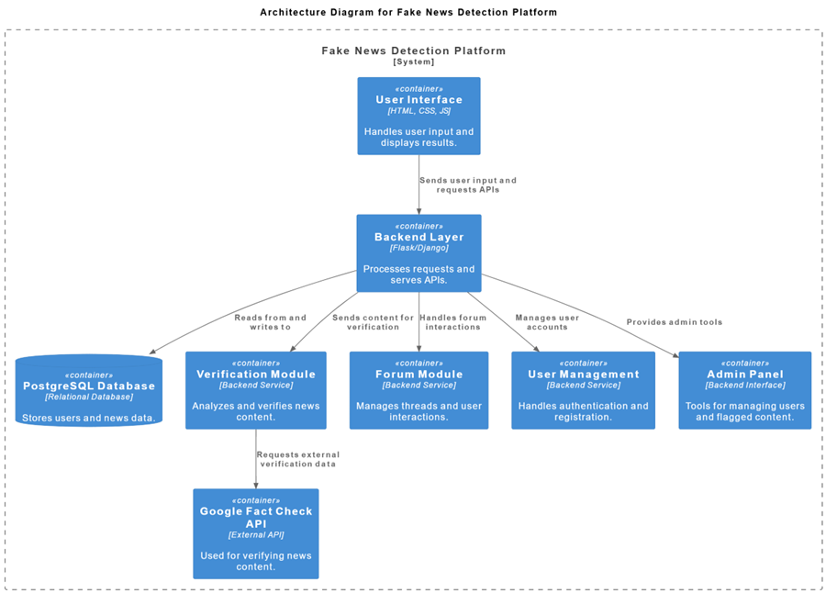
GENERAL ARCHITECTURE DIAGRAM
This diagram shows the platform’s main components:
Frontend (HTML/CSS/JS): Handles user input and displays results with responsive design.
Backend (Flask): Processes requests, serves APIs, and runs business logic.
Database (PostgreSQL): Stores user data, news submissions, verification results, and forum content.
External APIs (Google Fact Check, Azure Text Analytics): Used for verifying news content and analyzing text.

Slide 15
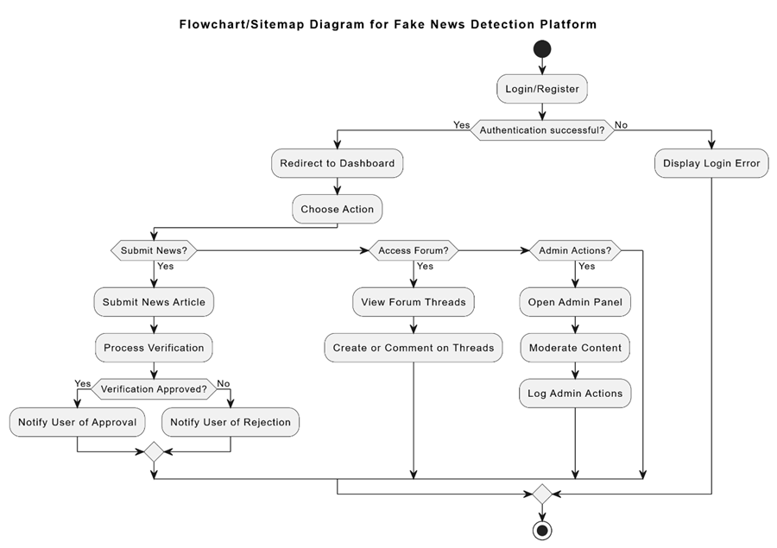
FLOWCHART/SITEMAP DIAGRAM
The flowchart visualizes the user's journey:
Login/Register: Users authenticate before proceeding.
Actions: After login, users can submit news, access forums, or perform admin actions.
Verification Process: Submitted news is processed and users are notified of the results.

Slide 16
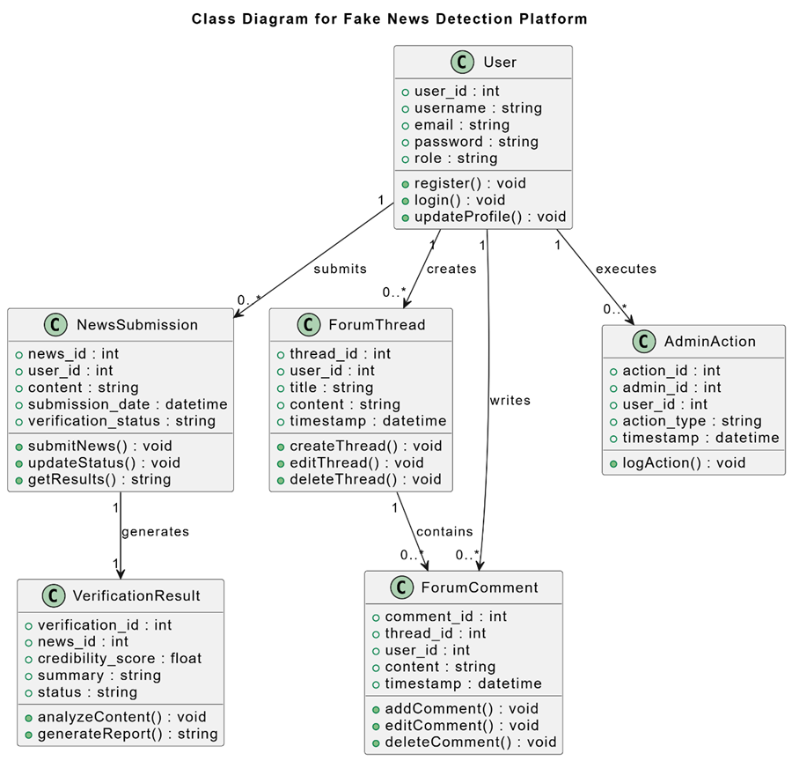
CLASS DIAGRAM
Defines key system classes and their relationships:
User: Stores user information and manages actions like login and profile updates.
NewsSubmission: Represents submitted news, tracking details like content and verification status.
VerificationResult: Contains the outcome of news verification, including credibility scores and summaries.
ForumThread/ForumComment: Manages discussions with threads and comments.
AdminAction: Logs actions performed by administrators, such as moderating content.

Slide 17
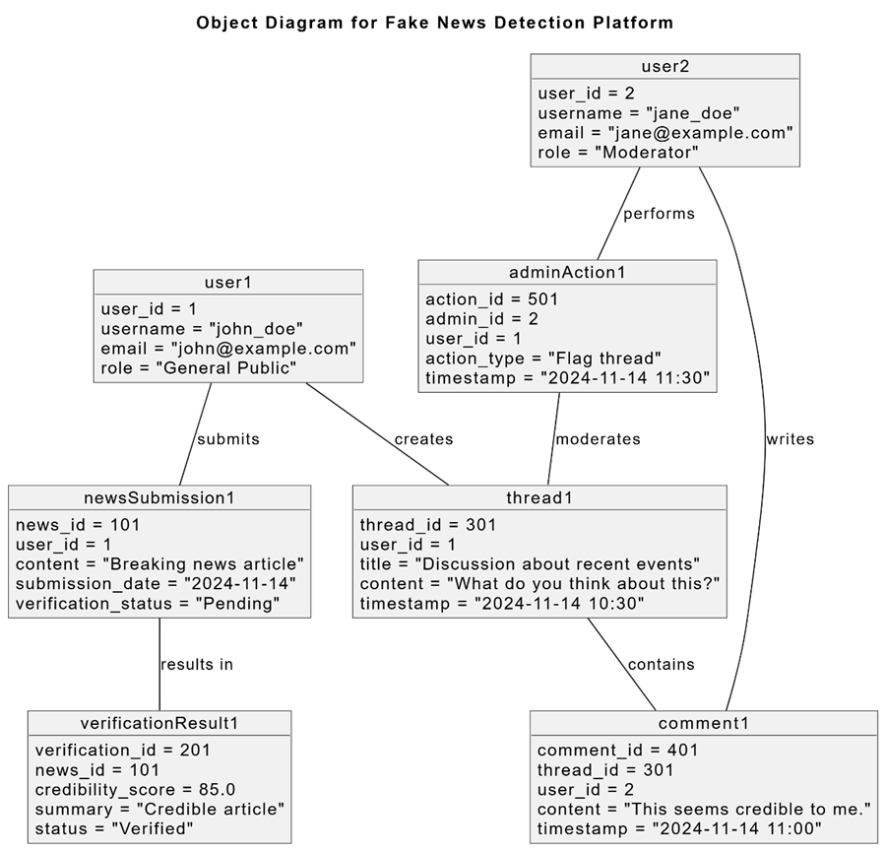
OBJECT DIAGRAM
Shows specific instances of classes in action:
user1 (General User): A user with specific attributes like username and role.
newsSubmission1: Represents a specific news article submitted for verification.
verificationResult1: The result of verifying the news article.
adminAction1: Represents an action taken by an admin, like moderating a thread.

Slide 18
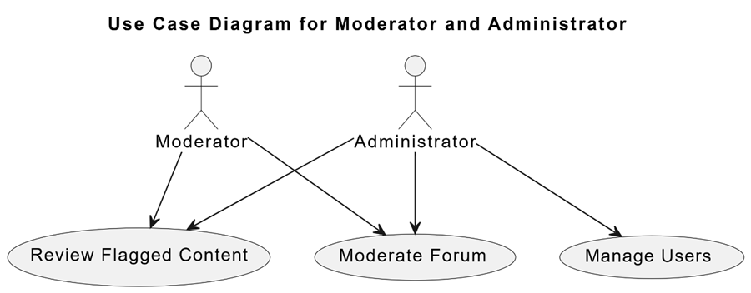
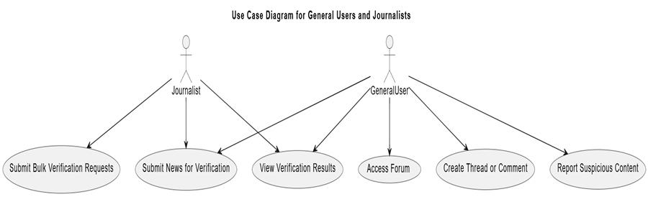
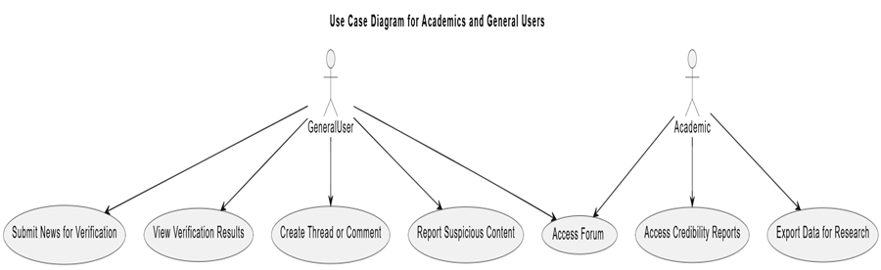
REFINED USE CASE DIAGRAM
Groups user actions by role:
General User: Can submit news for verification, view results, participate in forum discussions, and report content.
Journalist: Can submit multiple news items for verification and view detailed results.
Academic: Accesses credibility reports and exports data for research.
Moderator: Manages forum content and reviews flagged submissions.
Administrator: Manages users, moderates content, and reviews flagged posts.

Slide 19
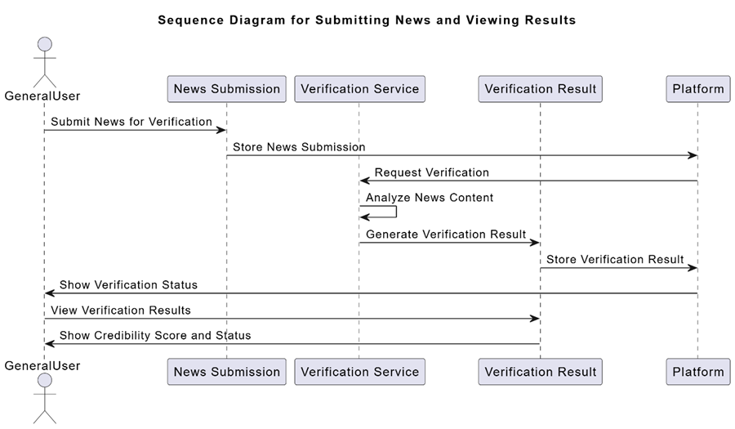
SEQUENCE DIAGRAM
This diagram tracks the sequence of actions when a user submits news:
User submits news for verification.
Backend stores news and sends a verification request.
Verification service analyzes content and generates a result.
Result is displayed to the user, including credibility score and status.

Slide 20
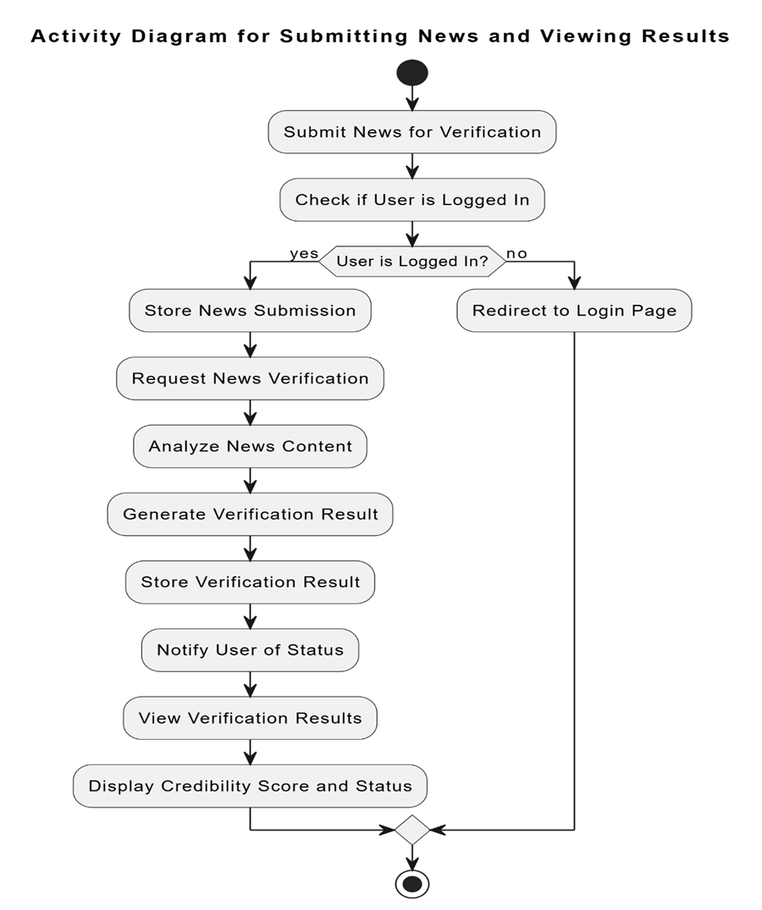
ACTIVITY DIAGRAM
This diagram shows the flow of activities:
Submit news for verification.
Check if the user is logged in—if not, redirect to the login page.
Store and verify news if logged in, then notify the user of the results.
Display verification results with the credibility score and status

Slide 21
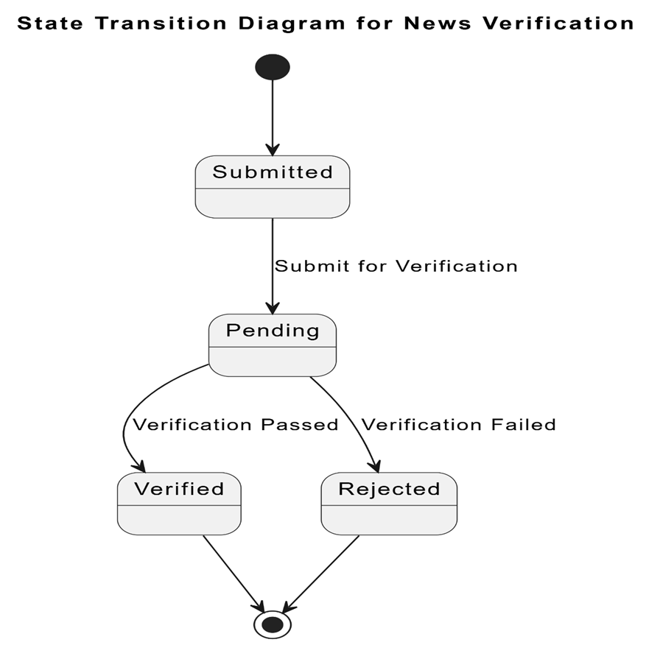
STATE TRANSITION DIAGRAM
Shows the states of a news submission:
Submitted: News is submitted.
Pending: News is under verification.
Verified: News is verified as credible.
Rejected: News fails verification.
Transitions happen based on the verification result.

Slide 22
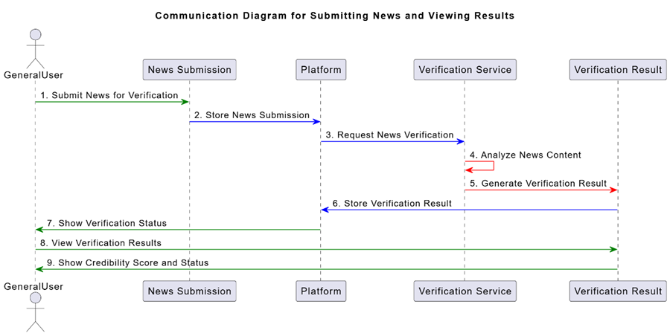
COMMUNICATION DIAGRAM
llustrates the interactions between the user, submission system, verification service, and result:
User submits news.
Platform stores news and requests verification from the service.
Verification service analyzes news and returns a result.
Platform displays the result to the user, including credibility score and status.

Slide 23
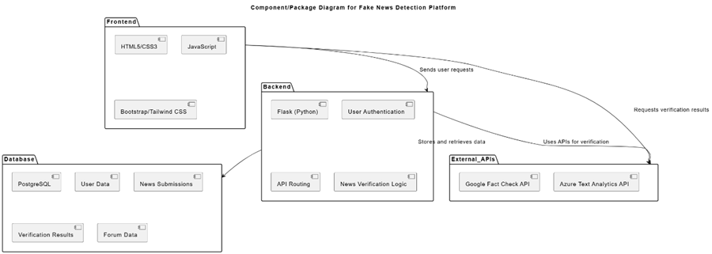
COMPONENT/ PACKAGE DIAGRAM
Depicts the system's modular structure:
Frontend: Built with HTML, CSS, JavaScript, and frameworks like Bootstrap/Tailwind.
Backend: Flask processes requests, handles user authentication, and manages news verification.
Database: PostgreSQL stores user, news, verification, and forum data.
External APIs: Google Fact Check and Azure Text Analytics for additional verification and analysis.

Slide 24
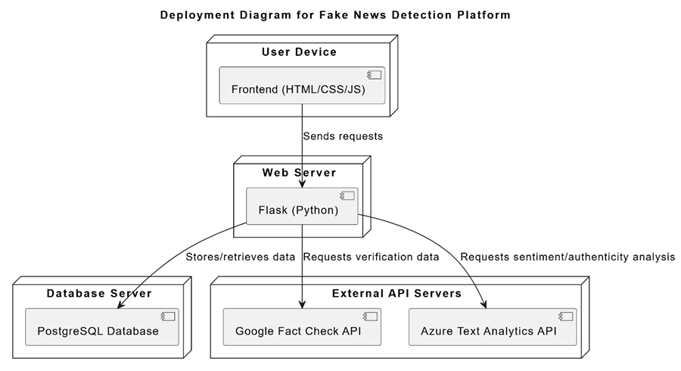
DEPLOYMENT DIAGRAM
Shows how the system is deployed:
User Device: Runs the frontend (HTML/CSS/JS).
Web Server: Hosts the Flask (Backend) application.
Database Server: Stores data using PostgreSQL.
External API Servers: Provide news verification and analysis via the Google Fact Check and Azure APIs.

Slide 25
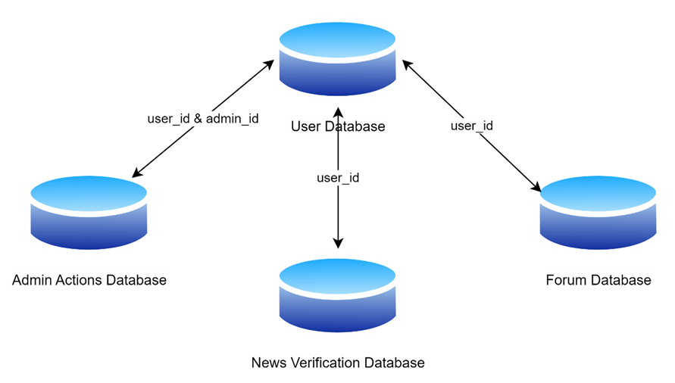
DATABASE DIAGRAM
Illustrates the structure of the platform's databases:
User Database (UserDB): Stores user details like username, email, and role.
News Verification Database (NewsDB): Stores submitted news and verification results.
Forum Database (ForumDB): Manages forum threads and comments.
Admin Actions Database (AdminDB): Logs actions taken by admins.

Slide 26



CONCLUSION
Fake News Detection Platform addresses the growing issue of misinformation by enabling users to verify news credibility and engage in discussions. With features like real-time verification, role-based access, and a scalable architecture, the platform empowers users to make informed decisions. As it evolves, the platform will integrate additional fact-checking services and advanced algorithms to further improve news verification.

Slide 27

THANK YOU
FOR ATTENTION

